Slide 1


Green Pace
Security Policy Presentation
Developer: Shayla Vincent

Slide 2

OVERVIEW: DEFENSE IN DEPTH
To create a protected system, use Defense In Depth.

Slide 3
THREATS MATRIX
[Populate the Threats Matrix table and provide explanations to summarize of all of your security risks.]
Likely Strings correctness Memory unprotected | Priority Exceptions Buffer Overflows SQL Injections
Low priority | Unlikely Wrong Data Type/Value Misplaced Assertions Precedence

Slide 4
10 PRINCIPLES
Validate Input Data
Heed Compiler Warnings
Architect and Design for Security Policies
Keep It Simple
Default Deny
Adhere to the Principle of Least Privilege
Sanitize Data Sent to Other Systems
Practice Defense in Depth
Use Effective Quality Assurance Techniques
Adopt a Secure Coding Standard

Slide 5
CODING STANDARDS
SQL Injection
Buffer Overflows
Exceptions
Memory Protection
String Correctness
Assertions
References to Containers
Data Type
Data Value
Precedence

Slide 6
ENCRYPTION POLICIES
Encryption at rest | This is the policy of encrypting the data where it is stored.
Encryption in flight | Encryption in flight is the policy of keeping the data encrypted as it moves.
Encryption in use | Encryption in use is the policy of leaving the data encrypted when using it in the program.

Slide 7
TRIPLE-A POLICIES
Authentication | Authentication is the way the application, or program, identifies a user.
Authorization | Authorization as a security policy is the concept of only allowing users to access information and functions that they require to perform their unique tasks.
Accounting | Accounting is a security policy that records access.

Slide 8
Unit Testing
Verify adding a single value to empty collection
Verify adding five values to empty collection
Verify resizing increases the collection
Verify out of range exception

Slide 9
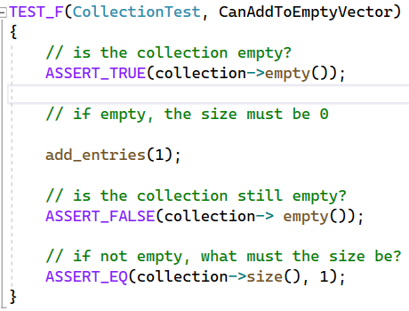
Verify Adding A Single Value To Collection

Slide 10
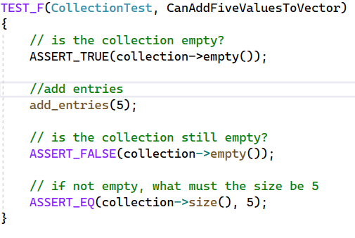
Verify adding five values to empty collection

Slide 11
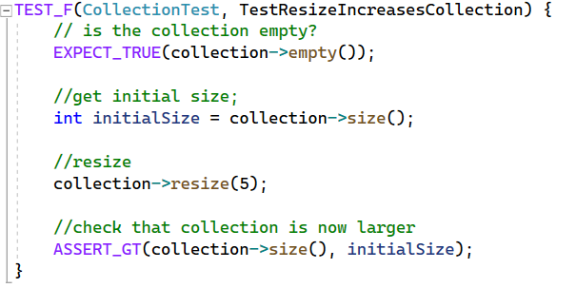
Verify resizing increases the collection

Slide 12
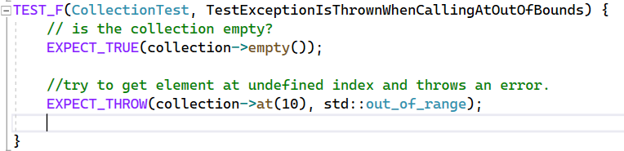
Verify out of range exception

Slide 13

AUTOMATION SUMMARY

Slide 14
TOOLS
Security Tool Automation

Slide 15
RISKS AND BENEFITS
Start: Now
Benefits
Protect data
Set Precedence
Detect failures
Cons
Cost

Slide 16
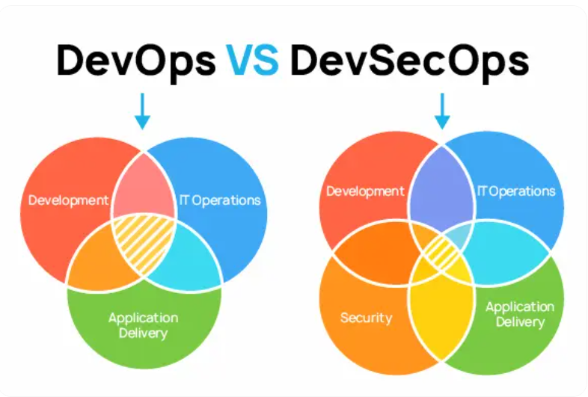
RECOMMENDATIONS
DevOps
Security only when testing

Slide 17
CONCLUSIONS
Focus on Security at every step
Real World Examples:
https://snyk.io/articles/Cultivating-DevSecOps-Culture-Real-world-implementations/

Slide 18
REFERENCES
Devops vs DevSecOps: Major similarities and differences. Instatus blog. (n.d.-b). https://instatus.com/blog/devops-vs-devsecops
Kelly, J. (2023, February 20). Security by design: Security principles and threat modeling. Red Hat - We make open source technologies for the enterprise. https://www.redhat.com/en/blog/security-design-security-principles-and-threat-modeling
Smith, J. (2020, March 19). DevSecOps examples: Successes and lessons learned. Snyk. https://snyk.io/articles/Cultivating-DevSecOps-Culture-Real-world-implementations/

